Slide 1
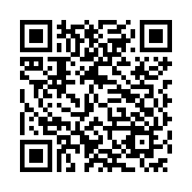
Tell Us
Tell s
Your
Views
Tell Us
Views
SHARE YOUR VIEWS ON HOW WE CAN IMPROVE ACCESS TO GP PRACTICE SERVICES
The NHS in Lincolnshire is currently working on the best way to develop and improve access to local GP practice services. Some of this work includes the best way patients can be offered GP practice service appointments outside of normal working hours (8am – 6:30pm). This may be referred to as “Enhanced Access”.
Your views are needed to help us shape the approach to how patients can access local GP Practice services in your area.
Please share your views by competing our survey
by ???
You can complete the survey online or paper copies are available in the your practice
Use Online Link: https://nhslincolnshire.qualtrics.com/jfe/form/SV_2ie9hxudD3IchUi
Use QR Code: (please scan using smart phone camera):

